Slide 1

Ramrao Adik Institute of Technology
Department of Computer Engineering
B.E. INTERNSHIP - Final Review
On
“Software Development Internship at Unbox Robotics”
By
21CE1490 Saish Santoshkumar Chaskar
Guided by
Mr. Ujjval Pamnani
(Associate Director, Software Team)

Slide 2

Unbox Robotics
CIN No.: | U72900KA2019PTC124451
Industry/Sector of Company: | Automation Machinery Manufacturing
Name of Mentor | Mr.Ujjval Pamnani (Associate Director, Software Team)
Designation: | Software Development Intern
Emailid: | Saish.chaskar@unboxrobotics.com
Internship Duration: | [15/1/2025 – 15/6/2025, 6 months]

Slide 3
Outline
Overview of Company
Introduction of Project
Roles and Responsibilities
Analysis of Existing Solutions
Understanding of a Problem
Project Methodologies/Techniques
Design and Architecture
Skills Development
Implementation
Internship Progress Update
References

Slide 4
Overview of Company
Industry: Automation Machinery Manufacturing
Focus: Robotics-based fulfillment and distribution technology for e-commerce, retail, and logistics
Mission: Deliver efficient order fulfillment using advanced robotic systems
Vision: Become the global leader in logistics automation
Internship Duration: January 15, 2025 – July 15, 2025 (6 months)
Role: Software Development Intern (Fullstack)
Supervisor: Mrs. Poonam Gadge
Industry Mentor: Mr. Ujjval Pamnani, Associate Director (Software)
Objective: Develop tools to enhance automation and efficiency in robotic systems
Projects:
PCB Testing Tool for automated testing
UART communication for sensor integration

Slide 5
Introduction of Project
PCB Testing Tool:
Creating an internal testing software tool with UI interactions to automate the testing process of the PCB of different versions and models.
Objective: Automate testing of Printed Circuit Boards (PCBs) for various robotic systems
Challenges with Existing System:
Manual testing (1-2 hours per cycle)
Limited scalability and outdated UI
Proposed Solution:
Browser-based tool with modern UI
Tech Stack: React (Vite.js), FastAPI, PostgreSQL, C++ middleware, WebSocket

Slide 6
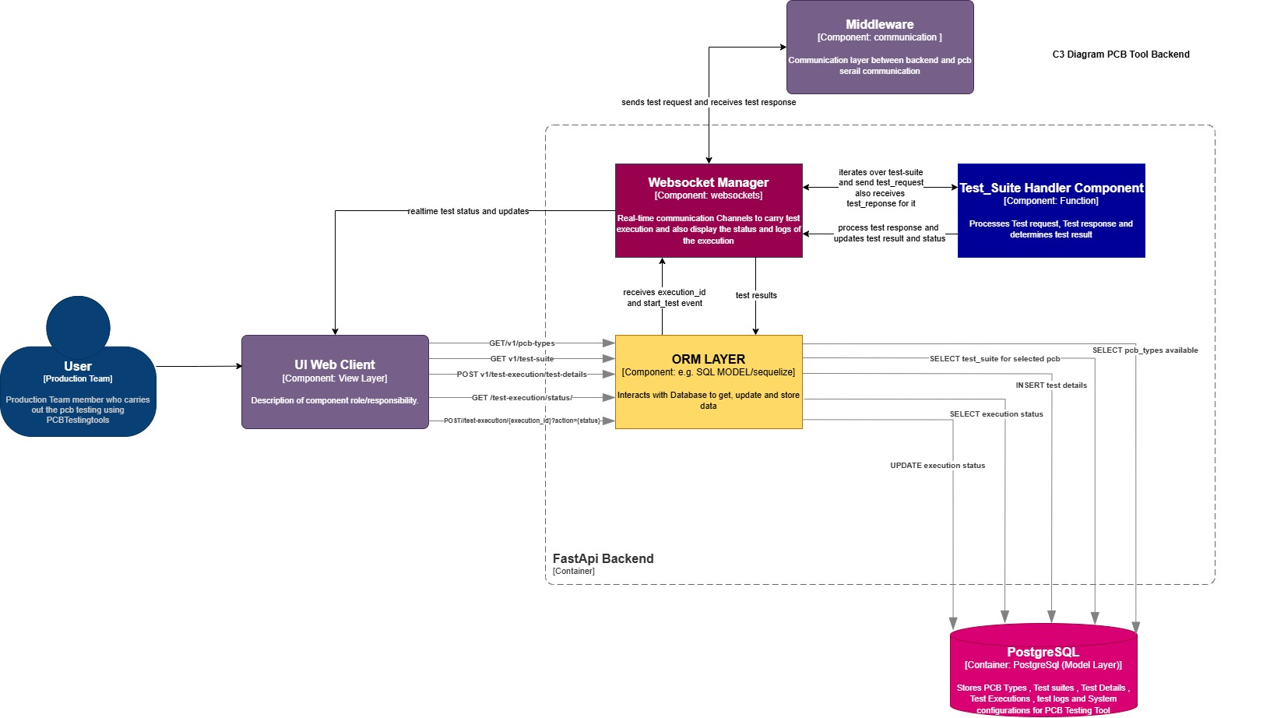
Architecture

Slide 7
Roles and Responsibilities
Designed intuitive user flows and scalable software architecture
Developed fullstack applications (React, FastAPI, PostgreSQL)
Implemented UART communication and C++ middleware
Conducted end-to-end testing and deployment
Debugged issues and documented technical findings
Collaborated with stakeholders for requirements and feedback

Slide 8
Project Methodology /Techniques
Methodology:
Literature review: Studied FastAPI, React, WebSocket, UART
Experimental approach: Conducted POCs for tech stack validation
Agile development with MVC architecture
Skills Gained:
Fullstack development (React, FastAPI, PostgreSQL)
Embedded systems (UART, C++ middleware)
Automation and testing workflows
Technical documentation and stakeholder collaboration

Slide 9
Skills Development
Software Development & Architecture :
System design, API development, and database management.
Backend (FastAPI) and frontend (React) development.
Embedded Systems & PCB Testing
Understanding PCB components, testing procedures, and automation.
Experience with C++ and IPC communication (Shared Memory).
Automation & Testing
Creating automated workflows for testing PCB versions.
Writing and executing test cases with report generation.
Project Collaboration & Documentation
Working with stakeholders for requirement gathering.
Writing technical documentation for software and hardware integration.

Slide 10
PCB Testing Tool - Implementation
Features:
Responsive UI for test configuration and result visualization
Real-time communication via WebSocket
Automated test execution and CSV report generation
Testing Strategies:
Unit testing for FastAPI and React components
Integration testing for WebSocket communication
Hardware testing for PCB outputs
Results:
Reduced testing time from 2-3 hours to 5 minutes
Consistent UI aligned with Unbox Robotics products
Version 1 developed, ongoing enhancements

Slide 11
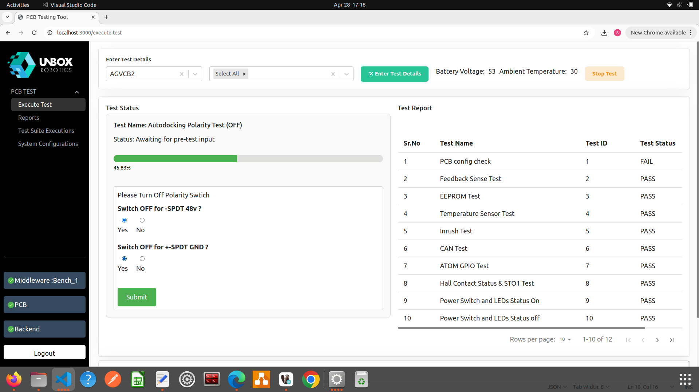
PCB Testing Tool Implementation – Results
PCB Testing Tool:
Reduced testing time by over 90%
Scalable architecture for diverse PCB versions

Slide 12
UART Implementation
Objective: Integrate PDS sensor into robots using UART on Intel Atom processor
Motivation: Minimize USB port usage (only 3 available)
Implementation:
Configured UART for 824 bytes every 43 ms
Developed C++ scripts for data processing and error handling
CSV logging for data analysis
Testing:
Tested baud rates and configurations using minicom
Analyzed logs to ensure no packet loss

Slide 13
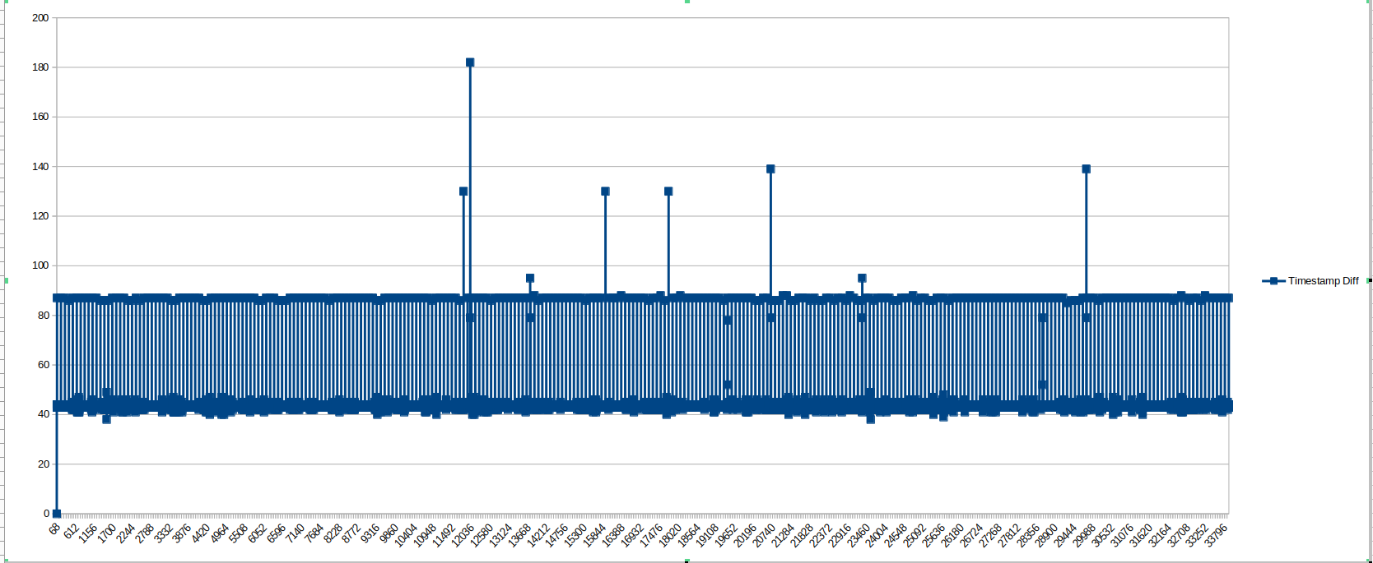
UART Implementation - Results
Achievements:
Average packet time: 42.82 ms (meets 43 ms requirement)
CPU utilization: <1.5% (target <3%)
Mitigated packet drop issues through error handling
Impact: Enabled reliable sensor data communication with minimal hardware resources

Slide 14
Internship Progress Update
Title: Unbox Robotics Initial Month Activities performed
Milestones Achieved and Tasks Completed:
Learnt about the software Architecture of system and started performing test execution and validation on the fix and releases released to get better understanding and deep understanding of the system.
Overtook an Initial Project to implement UART communication in C++
Analyzed the existing PCB testing tool for development of the newer version of it.
Software Architecture and Development of the PCB Testing Tool
Successfully contributed to automation at Unbox Robotics
Developed industry-relevant skills in fullstack and embedded systems
Projects improved operational efficiency and scalability
Valuable experience in a cutting-edge robotics environment

Slide 15
References
https://fastapi.tiangolo.com/
https://react.dev/reference/react
https://www.postgresql.org/docs

Slide 16
Thank You

